Slide 1
JREBEL FOR ECLIPSE
ECLIPSE DAY CHINA 2013

Slide 2

PRESENTER
ANTON ARHIPOV
@antonarhipov
PRODUCT MANAGER

Slide 3

A PRODUCTIVITY TOOL
FOR JAVA DEVELOPERS
BASED ON JAVAAGENT TECHNOLOGY
DISTRIBUTED AS IDE PLUGIN
Eclipse, incl. MyEclipse, RAD, etc
Also: IntelliJ IDEA, NetBeans, JDeveloper

Slide 4
THE TURNAROUND
MAKE
CHANGES
BUILD,
DEPLOY,
WAIT
AVERAGE: 2.5 min
OBSERVE
RESULTS

Slide 5
THE TURNAROUND
MAKE
CHANGES
BUILD,
DEPLOY,
WAIT
OBSERVE
RESULTS
NO BUILD!
NO REDEPLOY!
NO WAITING!

Slide 6
WASTED TIME
1-60 sec
30 sec – 30 min
~1 min
APPLICATION STARTUP
SERVER STARTUP
IN-APPLICATION NAVIGATION

Slide 7
HOW TO RELOAD A CLASS?
Old
Class Loader
New
Class Loader
MyClass
MyClass’
MyObject
MyObject
TRANSFER THE STATE

Slide 8
serialize/deserialize
init()
Session
Session
Classes
Sevlet
New Classes
Sevlet
App State
App State
Libraries
New Libraries
OldClassLoader
NewClassLoader
THIS IS WHAT EVERY APPLICATION SERVER DOES
Notes:
Class loader scope
Every deployed application gets a dedicated class loader
State recreation
Application state is recovered by reinitialization
Session state is (optionally) serialized and deserialized in the new class loader
Reloading time
Application reinitialization time, typically around one minute
Problems
Leaks memory
Lazy caches need to be warmed up every time

Slide 9
Session
Session
Classes
Sevlet
New Classes
Sevlet
App State
App State
New Libraries
OldClassLoader
NewClassLoader
CLASS LOADERS ARE EASY TO LEAK!
Notes:
Class loader scope
Every deployed application gets a dedicated class loader
State recreation
Application state is recovered by reinitialization
Session state is (optionally) serialized and deserialized in the new class loader
Reloading time
Application reinitialization time, typically around one minute
Problems
Leaks memory
Lazy caches need to be warmed up every time

Slide 10

THE REALITY:
CLASS LOADERS ARE NOT GOOD
FOR RELOADING CLASSES

Slide 12
HotSwap
Make changes
OldClassLoader
Debugger
MyObject.class
New code 111000100
101010010
HotSwap
Code 101000101
100010010
New code
111000100
101010010
MyObject

Slide 13
JRebel vs HotSwap
 | HotSwap | JRebel
Changing method bodies | + | +
Adding/removing methods | - | +
Adding/removing constructors | - | +
Adding/removing fields | - | +
Adding/removing classes | - | +
Adding/removing annotations | - | +
Replacing superclass * | - | -
Adding/removing implemented interfaces * | - | -

Slide 14
Maybe one day Java gets a better HotSwap:
JEP 159: Enhanced Class Redefinition
But class reloading is not enough for real applications!

Slide 15
JRebel
Make changes
OldClassLoader
JRebel
MyObject.class
Code 101000101
100010010
Framework
New code
111000100
101010010
MyObject
Configuration
(XML, annotations,..)

Slide 16
JRebel does NOT create new class loaders to update classes!

Slide 17

DEMO TIME!

Slide 18
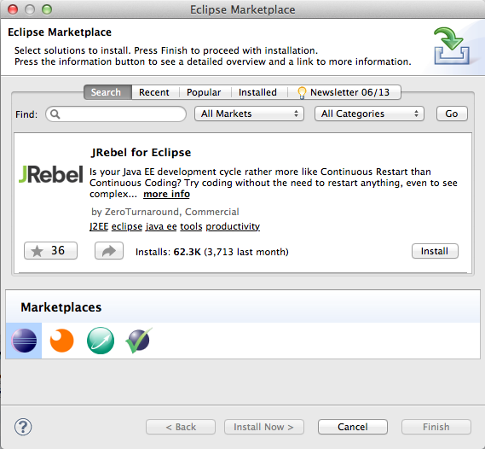
GET AT ECLIPSE MARKETPLACE

Slide 19
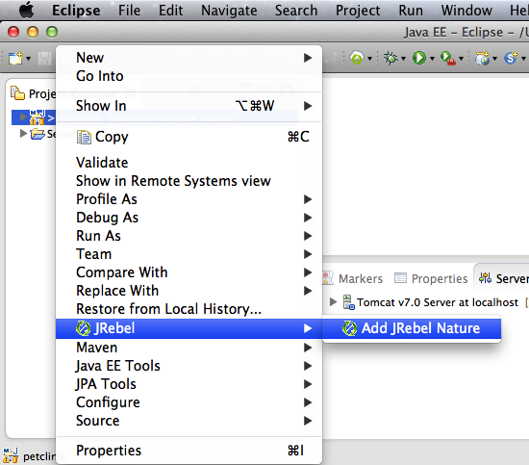
ADD JREBEL NATURE

Slide 20
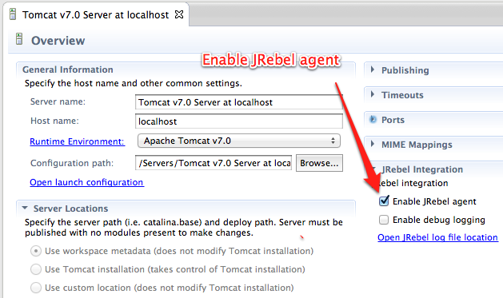
ENABLE JREBEL AGENT

Slide 21
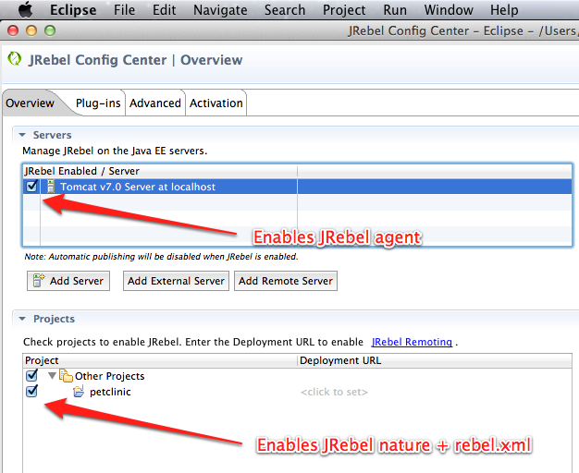
JREBEL CONFIG CENTER

Slide 22
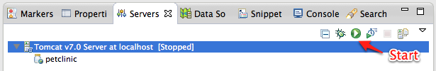
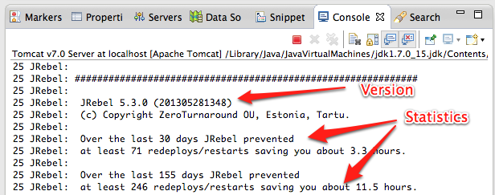
By starting the container you will
see JRebel messages like below

Slide 23
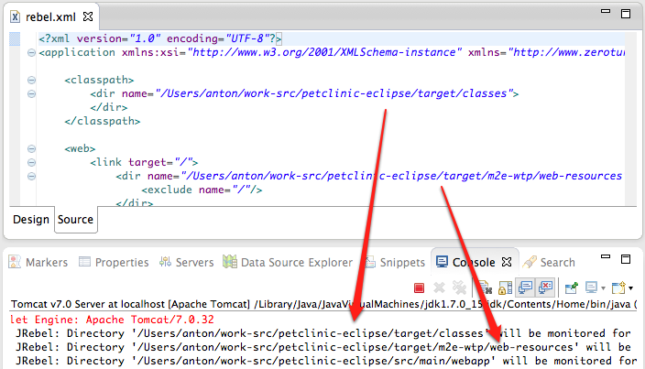
REBEL.XML
JRebel monitors directories specified in rebel.xml

Slide 24
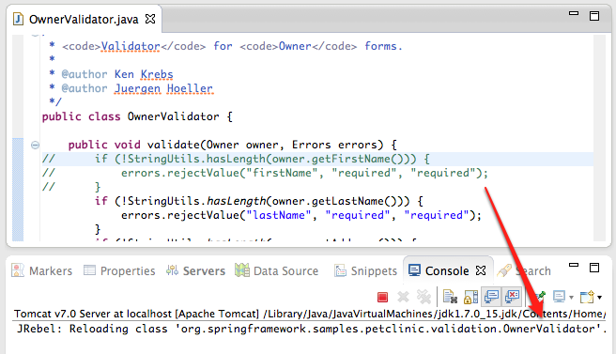
INSTANT CLASS RELOADING
JRebel reloads only what’s changed

Slide 25
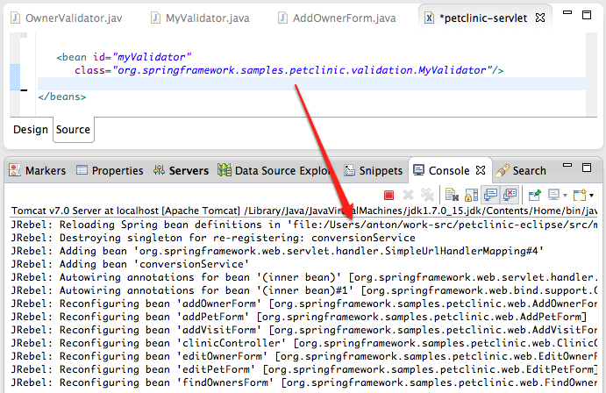
FRAMEWORK CONFIGURATIONS
JRebel understands framework configuration files

Slide 26
























http://zeroturnaround.com/software/jrebel/features/frameworks/

Slide 27
Questions?
@antonarhipov
anton@zerotunraround.com
http://www.jrebel.com

